Slide 1
NHS COVID App
Overview Diagrams
External system linking with Privacy
May 2020

Slide 2
Licensing & Usage
This document describes the Bluetooth proximity contact tracing application built by VMware Pivotal Labs for the UK Government.
You may re-use the text of this document (not including logos) free of charge in any format or medium, under the terms of the Open Government Licence.
To view this licence, visit
https://www.nationalarchives.gov.uk/doc/open-government-licence/version/3/
© Crown copyright

Slide 3
Overview
The Proximity Tracing App is a privacy ensuring service with no PII linking whatsoever. User research has shown that the more PII this application is linked to, the lower the uptake and usage of this app.
For these reasons we must have a way of allowing people in the app to ‘link out’ to other NHS services. These services may request more PII but that should not be stored in the Sonar backend. Conversely, the SonarID should not escape the Sonar backend in order to prevent others from linking in the future.
The external system though may wish to notify the Sonar backend that the use of this code is complete, and the status of the user has changed (E.g. positive/negative test result) - but no PII.
This presentation describes a privacy preserving mechanism built on the concept of a one time use reference code for each interaction with an external service elsewhere in the NHS.

Slide 4
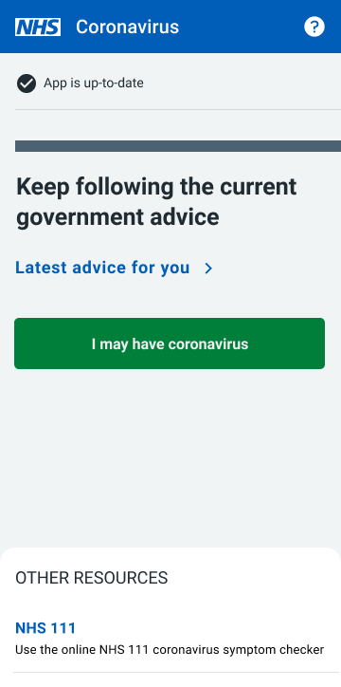
Approach for IoW phase Privacy protecting reference code
User clicks ‘show my reference code’.
This is displayed to the user E.g. ab5f-h38d
1.1
Additional data never goes in to Sonar - interaction happens outside of the app
App Back-end
1.1: App contacts NHS Sonar backend to generate a temporary reference code for their Sonar ID.

Slide 5
Approach for national launch reference code
Security: External system gateway needs to ensure a request cannot be misused to check for a valid reference code in Sonar.
Other systems ...
User clicks a link in the app for a specific function, or requests a one time use code
External System Gateway
1.2
2.2
In embedded
browser
Code passed, and other data from user requested.
1.1
2.1
2.3
Additional data never goes in to Sonar - it’s outside of the app
2.4
App Back-end
2.1 Gateway verifies this is a valid Reference Code with Sonar backend. (May not be done, subject to security note above)
2.2 Reference code may be passed to other backend systems
2.3: Gateway sends a status change to the Sonar backend that is useful for its function (E.g. test result positive/negative and date) along with the one time use reference code.
Sonar back-end destroys the reference code once results verified, or once it times out, removing any ability for PII linking between Sonar and NHS systems
2.4: (Optional) Depending on scenario, the back-end may send a notification to the main proximity tracing app
1.1: App contacts NHS Sonar backend to generate a temporary reference code for their Sonar ID.
1.2: App passes this reference code via the phone’s web browser to the external gateway service. The user interacts with this page.

Slide 6
Display of the reference code
The code will be displayed in the Mobile App for the Isle of Wight phase as an alpha-numeric set of digits.
We are using Crockford’s Base 32 to generate a visual alphabet. This eliminates the characters I, L, O and U. This helps prevent the commonest confused characters and the generation of accidental obscenity.
An example code:-
6db8-2hjt
This is lowercase for readability.
We were unable to remove some potentially confusing letters (e.g. 2 being confused with an uppercase Z) because we need at least 32 characters for encoding.
This functionality may be retained for future versions, including national roll out, based on need.

Slide 7
How the value is constructed
How a value is created:-
A value is constructed using a secure random number generator
The first 35 bits are taken
  This results in a 2^35 address space = 34 359 738 368 values
A 5 bit checksum is constructed using a Damm algorithm and appended to the data bits. (This can be easily used to check validity in excel)
Giving a total size of 40 bits
How the resultant data is displayed and used:-
5 bits = 1 visual character using a 32 bit alphabet (Because 2^5 = 32)
This gives 8 characters to cover the full 40 bits
This will be returned as a lowercase alphanumeric hyphen separated string
The linking code will be temporary (E.g. up to 2 weeks old), and deleted upon expiry
For external system linking (E.g. testing) the code will expire upon first use
We ensure that they are unique in the database

